Slide 1
Ball Buddy
Created by: Chris Sydnor, Zac Chaffin, Abdulhadi Altamaimi, Hyejun Park, Bryce Vida

Slide 2
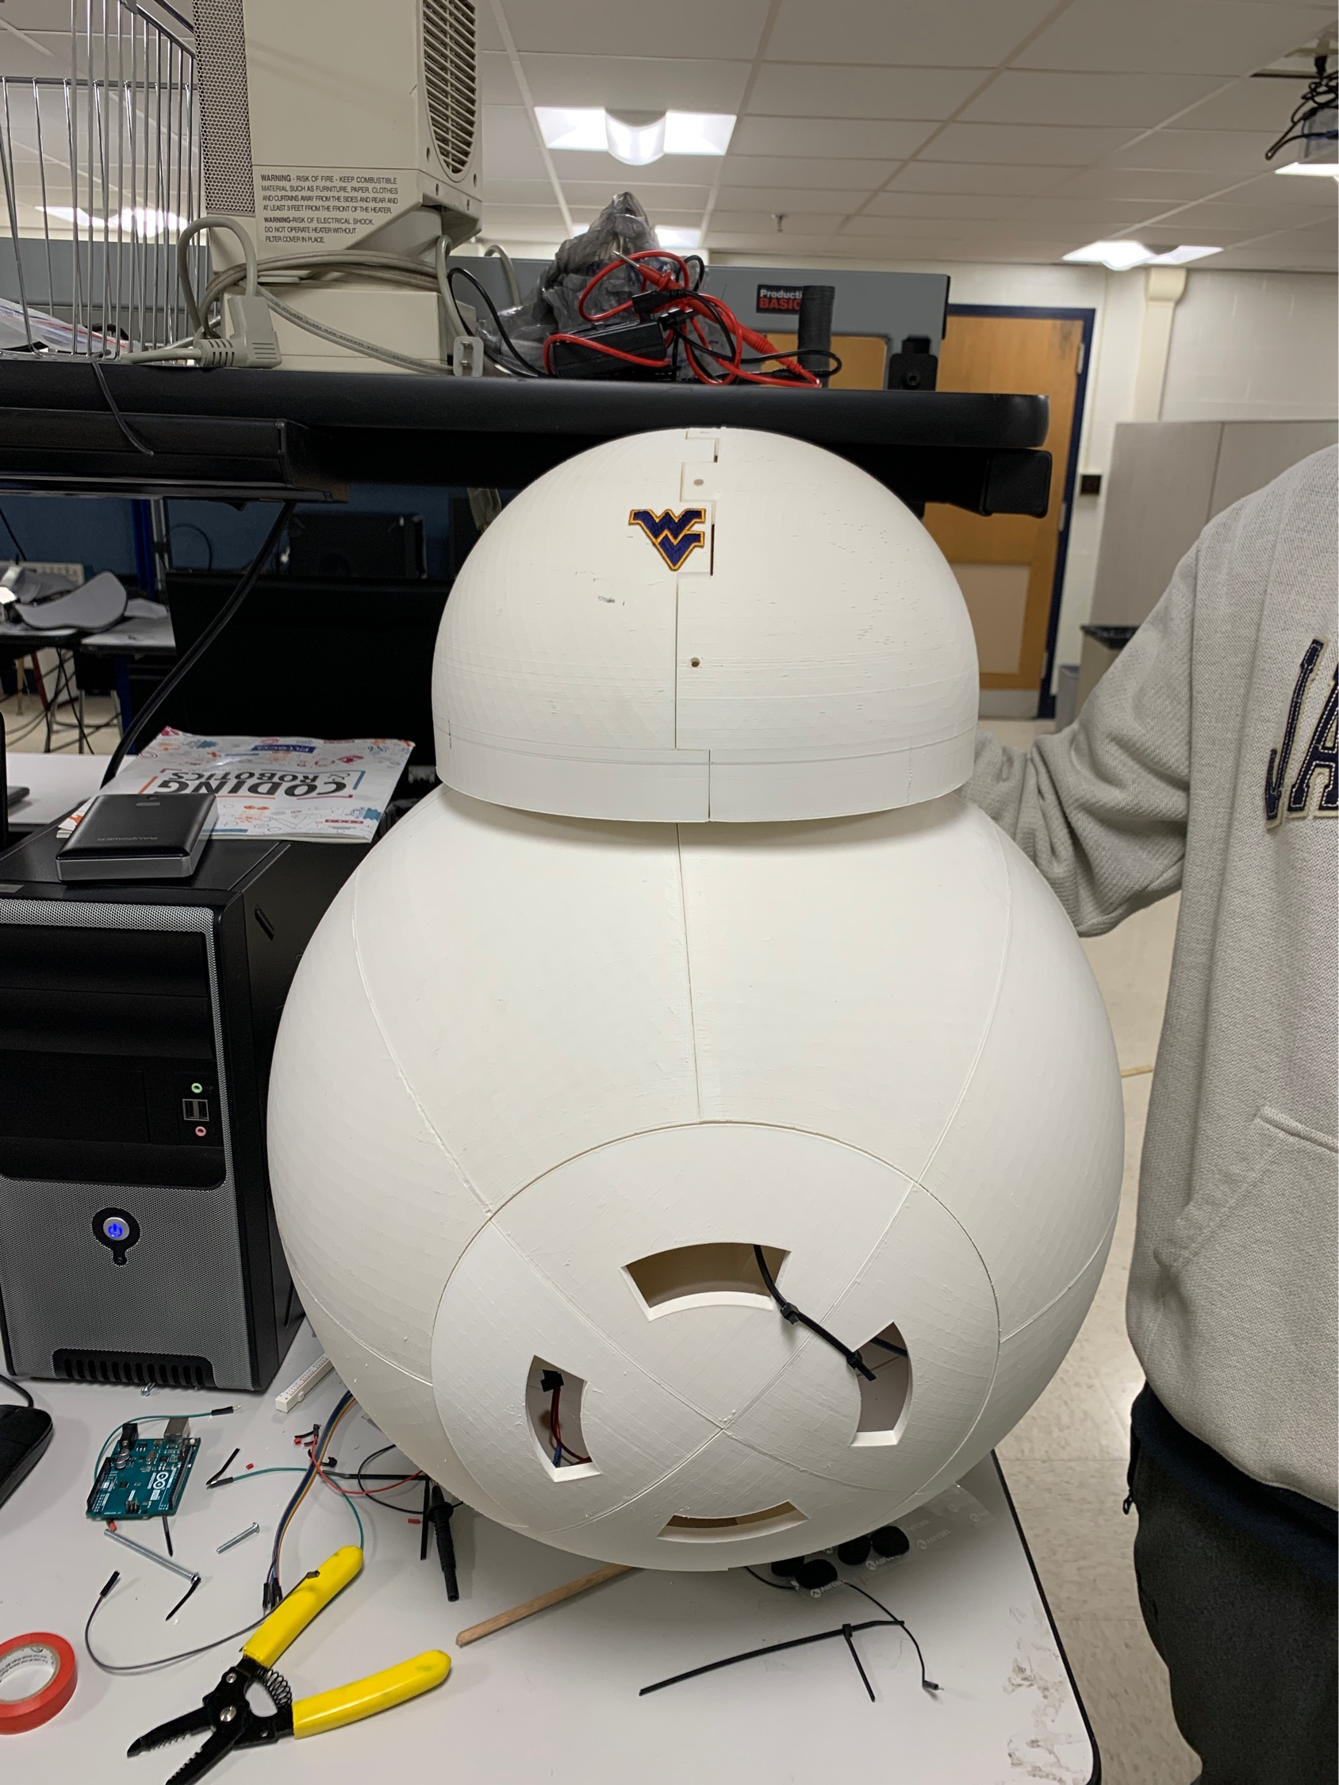
Outline
1. Problem Statement
2. Goals and Objectives
3. System Architecture
4. System Details
5. User Interface
6. Actual Accomplishments
7. System Demo
8. Suggestions for future development

Slide 3
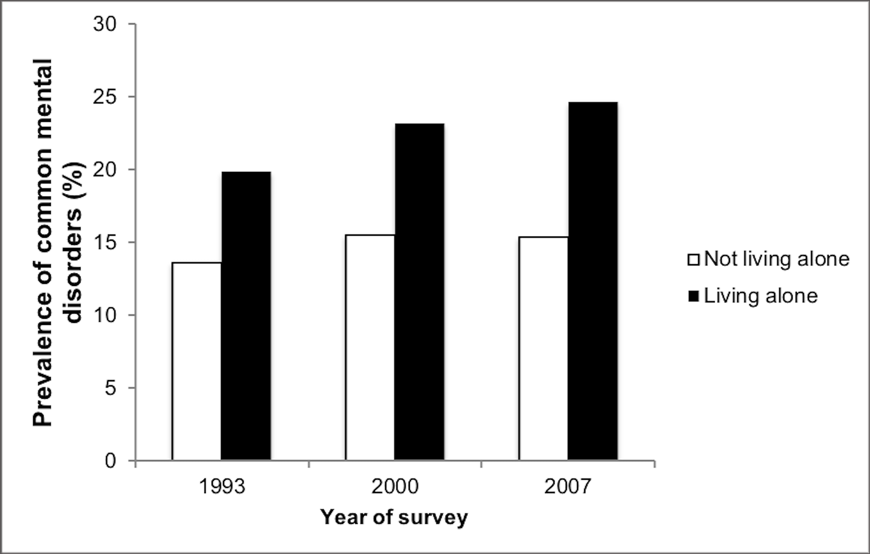
Problem Statement
Living alone can lead to the development of depression, obesity, drug-usage and other harmful habits/mental disorders. A study by Louis Jacob, Josep Maria Haro, and Ai Koyanagi shows that loneliness explained 84 percent of those living alone-common mental depressions.
The study concludes addressing loneliness among individuals living alone is particularly important for the mental wellbeing of this vulnerable population.
Prevalence of common mental disease

Slide 4
Solution: Ball Buddy
Our attempt at aiding those alone is the friendly bot: Ball Buddy.
The purpose of Ball Buddy is to give the person a companion while they are living alone. Ball Buddy is a remote controlled rolling robot that is able to be controlled via an Android application.
Ball Buddy’s size and friendly appearance aims to comfort the user and make them feel as though they aren’t alone.

Slide 5
Goals and Objectives
Moving: Ball Buddy will be able to drive in the directions that are determined by the user via a game controller.
Dance Functions: Ball Buddy will be able to move in predetermined patterns that serve to entertain the user.
Stereo System: Ball Buddy will be able to play music via bluetooth control.

Slide 6
Goals and Objectives cont.
HotSpot: Ball Buddy will have a HotSpot system built into it to provide WiFi to the users. This will provide mobile connectivity to WiFi dependent devices that the user relies on.
IR Wall Detection: Ball Buddy will avoid moving into areas marked by a user placed infrared wall device.
Video Output: Ball Buddy should provide a video stream allowing the user to drive the bot through its eyes.

Slide 7
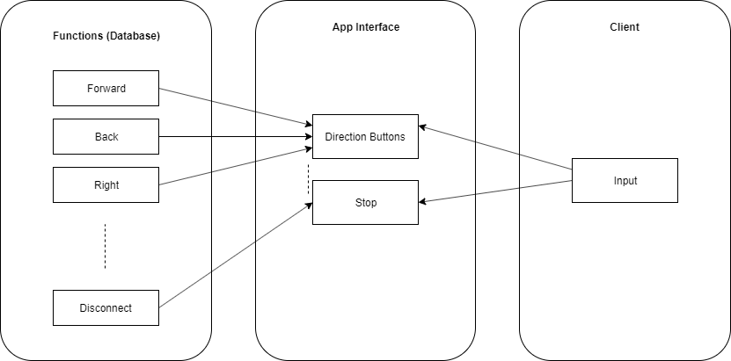
System Architecture
Software Architecture
User will be able to download an app and control the robot with the functions that are stored.
Notes:
include highlights of technologies and innovative ideas

Slide 8
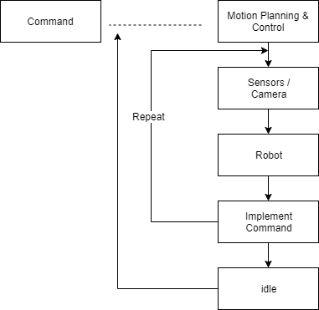
System Architecture
Hardware Architecture
Robot will poll sensor data from sensor and display surroundings with the camera attached while it receives commands from the software architecture.
Notes:
include highlights of technologies and innovative ideas

Slide 9
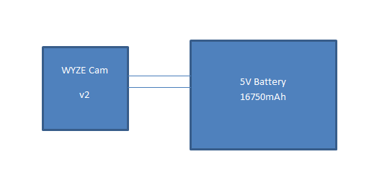
Head Circuit

Slide 10
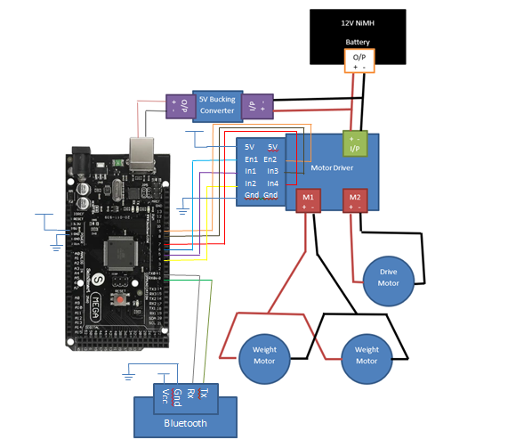
Inner Circuit
Arduino Mega 2560 R3
Handson Technology XY-160D Motor Driver
Pololu D24V150F12 12V to 5V Bucking Converter
12V 3000mAh NiMH Battery x2 in Parallel
HD Premium Planetary Gear Motor, 118 rpm 958.2 oz-in Driver Motor
TETRIX® MAX DC Motor, 152 rpm 320 oz-in Weight Motors
DSD TECH HM-10 Bluetooth 4.0 BLE iBeacon

Slide 11
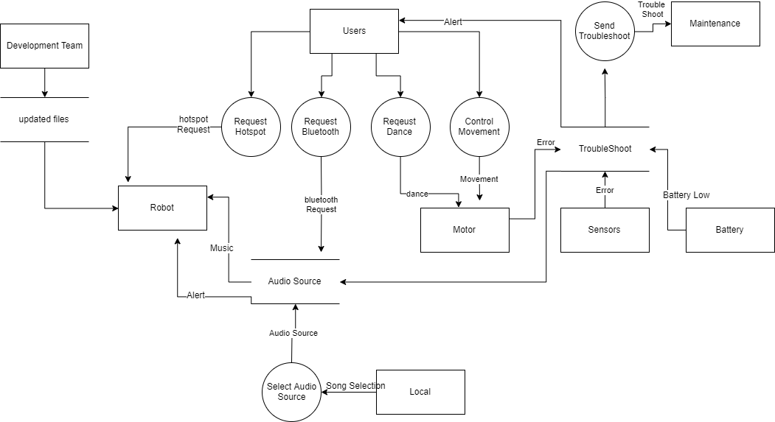
Diagrams
Data Flow Chart

Slide 12
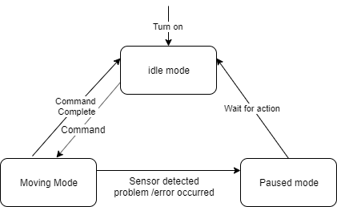
Diagrams
State Transition Diagram

Slide 13
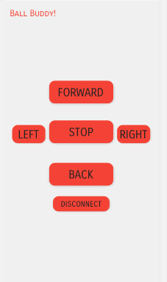
User Interface
After connecting with the Ball Buddy using the app, the screen on left will be provided to users.
The buttons contains each functions such as moving forward, left, right, back, and stop. The user can disconnect with the robot by pressing the disconnect button.
User Interface will be updated after completion of other functions such as dance functions
This interface is not the final design but a general layout for testing purposes.
Notes:
Discuss how the user interface works, how to use it, and overall demo of the user interface

Slide 14
Accomplishments
Design durable, efficient, and replaceable body panels.
Successfully connected with bluetooth model
Developed user-friendly and simple app to control Ball Buddy via android application
Able to drive forward, backwards, and is able to turn left and right
Able to send video from head which can be streamed

Slide 15
Demonstration

Slide 16
Suggestions for Future Development
For Future Development,
Develop an application in ios interface to support users
Develop and adopt AI to Ball Buddy to maximize comforts and efficiency for users
Adopt other technologies such as fall detection via camera or its sensors and track users to support and alert user’s emergency status to family or doctor.
It can be expanded based on ideas that we were unable to implement

Slide 17
Bibliography
https://journals.plos.org/plosone/article?id=10.1371/journal.pone.0215182
Chew-Graham, Carolyn A, and Mo Ray. Mental Health And Older People. 2016.

Slide 18
Questions?

